Slide 1


Vidya Prasarini Sabha’s
College of Engineering And Technology, Lonavala
CAMPUS PLACEMENT PREDICTION AND ANALYSIS
Guide Name: Dr. Manav Thakur Sir
Group Members:
Rushikesh Joshi
Roshan Dandge
Vijay Shilwant
Shreyash Rajput

Slide 2
INDEX
Abstract
Introduction
Purpose
Existing System
Proposed System
Modules
Benefits
Conclusion
References

Slide 3

ABSTRACT
The "Campus Placement Prediction Android Application" is a user-friendly mobile app designed to aid students and placement officers in the campus recruitment process. Students can create profiles with academic details and skills, receiving insights to identify their strengths and weaknesses.
placement officers can access the app to search for potential candidates, viewing a ranked list of suitable students. Real-time notifications keep users informed about job openings and events. Interactive workshops and webinars enhance students' skills and industry knowledge. The app prioritizes data security and offers an intuitive interface for seamless navigation.

Slide 4

INTRODUCTION
The "Campus Placement Prediction Android Application" is a modern solution that revolutionizes the campus recruitment process. Built for Android devices, it combines data analytics and machine learning to assist students and placement officers. This app offers students insights into their strengths, predicts their chances of placement success, and suggests personalized improvements.
For placement officers, it provides data-driven candidate rankings and simplifies the candidate selection process. By leveraging technology and user-friendly design, this application enhances the efficiency and effectiveness of campus placements, benefiting both students and placement officers in finding the best-fit opportunities and candidates.

Slide 5
PURPOSE
The purpose of the "Campus Placement Prediction Android Application" is to fundamentally transform the traditional campus recruitment landscape by harnessing the power of data-driven insights and predictive analytics.
For students, the app serves as a guiding light, By analyzing their academic performance, skills, and other relevant attributes, the app predicts the likelihood of their placement success. Additionally, the app provides personalized recommendations, enabling students to make informed about skill enhancement and career choices , also driven opportunities.
On the placement officer's end, the application revolutionizes candidate selection. It employs historical placement data and machine learning algorithms to rank candidates based on their predicted placement success.
Overall, the purpose of the "Campus Placement Prediction Android Application" is to bridge the gap between students and placement officers, By empowering students to enhance their profiles and aiding placement officers in identifying the best-fit candidates.

Slide 6

EXISTING SYSTEM
The current campus placement prediction system, often relying on Excel sheets, presents several challenges due to its manual and spreadsheet-based nature. Using Excel for this purpose introduces issues such as data complexity, error-prone manual data entry, and scalability limitations. Advanced analytics and real-time updates are also lacking, leading to inaccurate predictions and delayed information dissemination.
Excel-based systems struggle to handle increasing data volumes and lack the capability to incorporate machine learning algorithms effectively. Collaboration among students, recruiters, and placement officers is hindered, impacting communication and decision-making. Moreover, concerns about data security and privacy arise due to Excel's vulnerability to breaches.

Slide 7

PROPOSED SYSTEM
The proposed system for the "Campus Placement Prediction Android Application" envisions a game-changing approach to campus placements, leveraging modern technology and user-friendly design. This system will empower students and recruiters alike through its key features.
For students, the system will facilitate the creation of detailed profiles showcasing their academic achievements, skills, and projects. Using data analytics, students will receive insights into their strengths and weaknesses, helping them make informed decisions about their career paths. The heart of the system lies in its predictive model, which will estimate the likelihood of a student's placement success based on historical data and individual profile attributes.

Slide 8

Recruiters will benefit from a specialized dashboard that simplifies candidate search, displaying a ranked list of potential candidates based on their predicted placement success. Real-time notifications will keep both students and recruiters informed about relevant events and job openings.
The system ensures data security and a user-friendly interface. By integrating technology and insights, the proposed system for the "Campus Placement Prediction Android Application" aims to revolutionize the placement process, fostering more informed and efficient outcomes for students and recruiters.

Slide 9
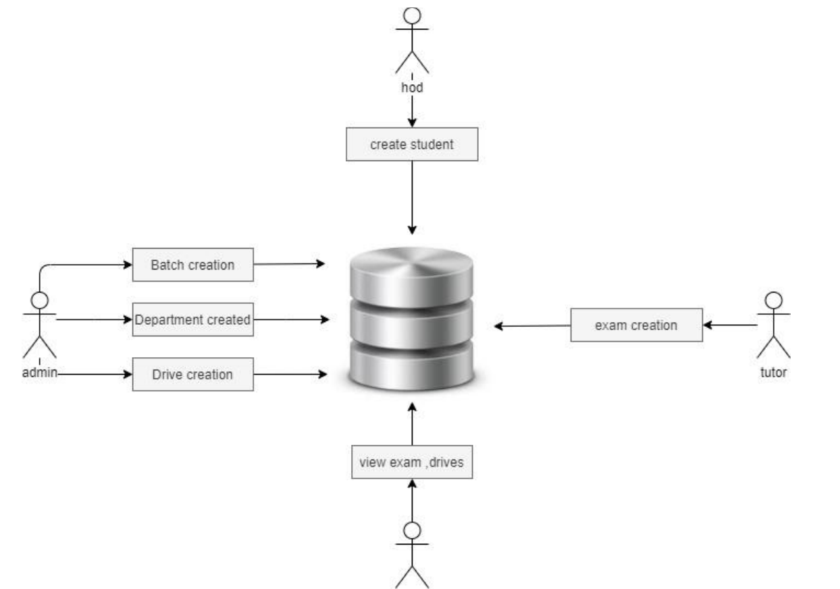
MODULES
Structure for Campus Placement Prediction Model

Slide 10

MODULES
The system contains 5 modules as admin(TPO) module, PRINCIPAL module, HOD module, STAFF module, student module. Each module has the login page.
Admin Module ➔
The Placement officer is the administrator of the system. Admin plays a very crucial role in the system.
Admin Dashboard➔
Manage Drives
Company Details(Edit/Delete)
Search Students
Departments
Manage Exam
Manage Trainings
Academic Calendar
Batches ( Add / Delete)
Prediction

Slide 11
HOD Dashboard➔
Placement drives
Student details
Student Instructions
Assign Staff
Academic calendar
Principal Dashboard➔
Placement drives
Company details
Search students
Academic calendar
Staff Dashboard➔
Placement drives
Student details
Exam
Notes
Instructions
Academic calendar
Student Dashboard ➔
Placement Drives
Student profile
Academic Calendar
Exam
Prediction & Analysis

Slide 12

Student Profile Information➔
Name
Email id
Mob No
Address
Department
Roll No
Photo
College Details

Slide 13

BENEFITS
Benefits for Students➔
1. Increased employability through aligned skill enhancements.
2. Efficient job search with relevant openings.
3. Confident career decisions with data-backed insights.
4. Competitive edge through industry insights.
5. Alumni networking for mentorship and referrals.

Slide 14

Benefits for Campus➔
1. Higher placement rates due to accurate predictions.
2. Enhanced reputation as a job-ready graduate producer.
3. Recruiter collaboration for increased opportunities.
4. Technology adoption showcases innovation.
5. Optimized resource allocation for better outcomes.
6. Global exposure with international job connections

Slide 20

CONCLUSION
In conclusion, the “Campus Placement Prediction Android Application” offers students tailored career paths and efficient job matches.
Placement officers benefit from improved resource allocation and industry insights, fostering successful collaborations with recruiters. A tech-driven approach to enhancing placement outcomes for both parties.

Slide 21
THANK YOU!!!!

